Slide 1
Capital Structure Decision
Ashok Banerjee

Slide 2
Relevance of Capital Structure Decision
Capital structure refers to the combination of debt and equity capital used by a company to finance long-term fixed assets and net working capital.
Capital structure decision has important implications for the value of the company and its cost of capital.

Slide 3
Relevance of Capital Structure Decision
The relevance of capital structure decision is that the value of a company can be maximized implying that the cost of its capital can be minimized by taking debt up to a particular level or with a specific debt-equity ratio.
The job of a financial manager is to determine that specific debt-equity ratio for maximizing the value of shareholders equity.

Slide 4
Financial Leverage and Its Impact
The financial leverage or gearing of a company is the ratio of debt to equity capital in its capital structure.
Leverage is also measured by Debt/EBITDA
Business risk is the riskiness of a company’s assets if it uses no debt.
Financial risk is the additional risk placed on the equity shareholders as a result of the use of debt by the company.

Slide 5
Financial Leverage and Its Impact
These risks are measured by the standard deviation of return on equity (σROE).
Total risk of equity shareholders = σROE
Business risk = σROE(u)= σROA
Financial risk = σROE - σROE(u)

Slide 6
Optimal Capital Structure
Though experts still debate on this issue, one can try to find an optimal structure by :
  Minimizing WACC; or
  Maximizing EPS

Slide 7
Multiple Choice Question - 3
A Company is planning its target capital structure. It has
estimated after-tax costs of debt and equity at different
levels of debt as follows :
Debt/Total Assets ratio Cost of equity Cost of debt
0 12.0 % -
0.10 12.0 % 8.0 %
0.20 12.0 % 8.0 %
0.30 13.0 % 8.5 %
0.40 13.5 % 9.0 %
0.50 14.0 % 9.5 %
0.60 14.5 % 10.0 %
What is the target debt-equity ratio for the company?
a) 0.25, b) 0.50, c) 1.00, d) 1.50

Slide 8
Multiple Choice Question - 3
Ans. (a)
Solution:
Debt to Total assets ratio WACC
0 12.0 %
0.10 9 * 12 + 0.1 * 8 = 11.6 %
0.20 8 * 12 + 0.2 * 8 = 11.2 %
0.30 7 * 13 + 0.3 * 8.5 = 11.65 %
0.40 6 * 13.5 + 0.4 * 9.0 = 11.7 %
0.50 5 * 14 + 0.5 * 9.5 = 11.75 %
0.60 4 * 14.5 + 0.6 * 10.0 = 11.8 %
So, target debt to total assets ratio = 0.2
And debt to equity ratio = 0.2/0.8
= 0.25

Slide 9
Problem
A Company needs Rs.10 million capital for its new green
field project. The net operating earnings is expected to be
30 % and the corporate tax rate is 40 %. The company
expects the following alternatives for raising the capital.
a) 100 % equity at Rs.20 per share
b) 40 % debt at 12 % interest and 60 % equity at Rs.16 per share
c) 30 % debt at 11 % interest, 20 % 12 % preference shares and 50 % equity at Rs.18 per share.
Which is the best alternative for the company for raising the capital?

Slide 10
Problem
Ans. Alternative (c)
Solution: We will undertake EBIT-EPS analysis for the three alternatives.

Slide 11
Problem
EBIT-EPS Analysis
(Fig. in Rs. Million)
Alternatives
(a) (b) (c)
Value of equity 10 6 5
Value of pref. shares - - 2
Value of debt - 4 3
No. of shares (million) 0.5 0.375 0.278
EBIT 3.0 3.0 3.0
Interest - 0.48 0.33
EBT 3.0 2.52 2.67

Slide 12
Problem
EBT 3.0 2.52 2.67
Taxes 1.2 1.01 1.07
EAT 1.8 1.51 1.60
Preference dividend - - 0.24
Earnings available to 1.8 1.51 1.36
Equity holders
EPS 3.60 4.03 4.89
Alternative (c) is the best since EPS is maximized in this case.

Slide 13
Theories of Capital Structure
Modigliani and Miller (MM) model
Trade-off model
Pecking Order Theory
Leverage Ratchet Effect
Market Timing Theory

Slide 14
Modigliani and Miller (MM) Model
MM model without corporate taxes (1958)
- MM Proposition I : The Pie Model
- MM Proposition II : The Cost of Equity and Financial Leverage
MM model with corporate taxes (1963)
- MM Proposition I
- MM Proposition II

Slide 15
Assumptions behind M&M
M&M reasoned that if the following conditions hold, the value of the firm is not affected by its capital structure:
  Condition #1: Individuals and corporations are able to borrow and lend at the same terms (referred to as “equal access”).
  Condition #2: There is no tax advantage associated with debt financing (relative to equity financing).
  Condition #3: Debt and equity trade in a market where assets that are substitutes for one another trade at the same price. This is referred to as a perfect market.

Slide 16
MM Model Without Corporate Taxes
MM Proposition I : The Pie Model
The market value of any firm is independent
of its capital structure and is given by
capitalizing its expected return at the rate
appropriate to its risk class.

Slide 17
MM Model Without Corporate Taxes
MM Proposition I : The Pie Model
V(lev) = V(unlev)
= EBIT / Keu

Slide 18
MM Model Without Corporate Taxes
where
V(lev) = market value of a leveraged company
V(unlev) = market value of an unleveraged company
Keu = cost of equity of an unleveraged company
EBIT = earnings before interest and tax

Slide 19
Assumptions of MM Model
MM made the following assumptions. Some of which are plainly unrealistic.
Capital markets are perfect. There are no transaction costs. Investors are rational and have symmetrical information. All investors have access to the same information and have identical estimates of each firm’s future EBIT.
Individual investors and firms can borrow or lend at the risk-free rate.
All cash flows are perpetuities. There is no growth in EBIT.

Slide 20
MM Model Without Corporate Taxes
MM Proposition II : The Cost of Equity and Financial Leverage
The cost of equity capital of a company is a linear
function of its capital structure.
The expected yield on a equity share is equal to the sum
of the appropriate overall capitalization rate, Ko/ Keu
corresponding to the risk class of business and a premium
due to financial risk equal to the debt equity ratio times the
difference or spread between overall capitalisation rate, Ko
and the cost of debt, Kd.

Slide 21
MM Model Without Corporate Taxes
MM Proposition II : The Cost of Equity and Financial Leverage
Ke = Keu + (Keu – Kd) * D/E

Slide 22
MM Model Without Corporate Taxes
where
Keu = Unlevered cost of capital
Ke = cost of equity capital
Kd = cost of debt
We = proposition of equity in total capital
Wd = proposition of debt in total capital
E = amount of equity capital
D = amount of debt capital

Slide 23
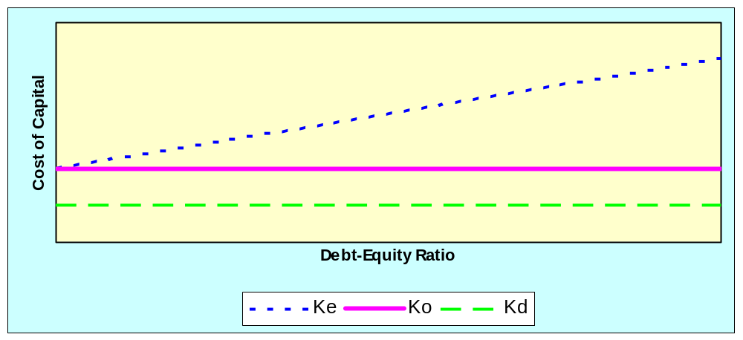
MM Model Without Corporate Taxes

Slide 24
MM Model With Corporate Taxes
Proposition I (Value of unlevered company)
The value of an unlevered company is:
Vu = EBIT*(1-t) / Keu
where
Vu = value of unlevered company
Keu = cost of equity of unlevered company
t = corporate tax rate

Slide 25
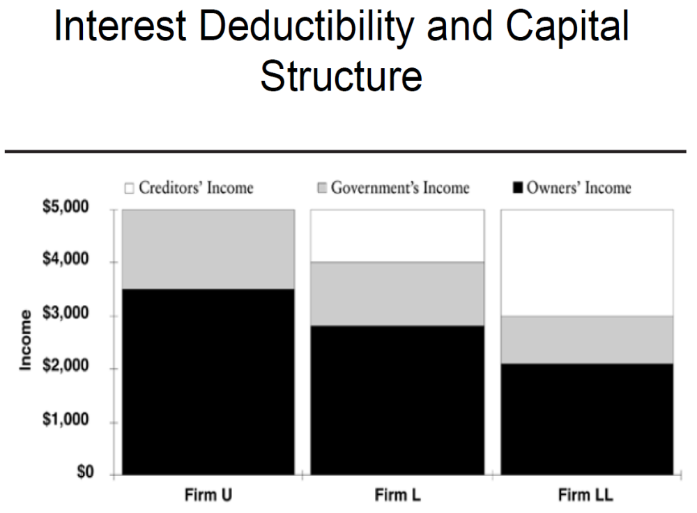

Slide 26
MM Model With Corporate Taxes
Proposition I (Value of levered company)
The value of a levered Company, when taxes
are considered is the value of unlevered company
in the same risk class plus the gain from leverage
which is the present value of interest tax shield.
The present value of interest tax shield is
obtained by capitalizing the interest tax shield
using the capitalization rate equal to the cost of
debt.

Slide 27
MM Model With Corporate Taxes
Proposition I (Value of levered company)
V(lev) = Vu + Dt
where
V(lev) = market value of levered company
Vu = market value of unlevered company
D = market value of debt
t = corporate tax rate

Slide 28
MM Model With Corporate Taxes
Proposition II (Cost of Equity of a levered company)
The cost of equity of a levered company, Ke
is the sum of the cost of equity of an
unlevered company in the same risk class,
Keu and a financial risk premium.

Slide 29
MM Model With Corporate Taxes
Proposition II (Cost of Equity of a levered company)
Ke = Keu + (Keu – Kd) * D/E * (1-t)

Slide 30
MM Model With Corporate Taxes
Proposition II (Cost of Equity of a levered company)
where
Ke = cost of equity of levered company
Keu = cost of equity of unlevered company
Kd = cost of debt
D/E = debt equity ratio
t = corporate tax rate

Slide 31
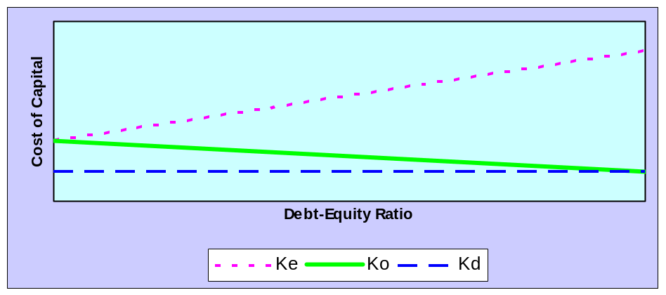
MM Model With Corporate Taxes

Slide 32
MM Model With Corporate Taxes - Example
A company has EBIT of Rs.40 million. The
company pays out all of its income as dividends.
The required rate of return, Keu is 15 % if no debt
is used depending on the business risk faced by
the company. It has debt capital of Rs.100 million
with interest payable at the rate of 10 %. The
corporate tax rate is 40 %. What is the WACC of
the company?

Slide 33
MM Model With Corporate Taxes - Example
The value of unlevered company that has
zero debt but pays taxes will be:
Vu = EBIT*(1-t) / Keu = 40*(1-0.4) / 0.15
= Rs.160 million

Slide 34
MM Model With Corporate Taxes - Example
The value of the company with debt capital
of Rs.100 million will be :
V(lev) = Vu + Dt
= Rs.160 million + Rs.100 million * 0.4
= Rs.200 million

Slide 35
MM Model With Corporate Taxes - Example
The value of equity capital of the company will be:
E = V(lev) – D
= Rs.200 million – Rs.100 million
= Rs.100 million

Slide 36
MM Model With Corporate Taxes - Example
The cost of equity capital of the company will be:
Ke = Keu + (Keu – Kd) * D/E * (1-t) = 0.15 + (0.15 – 0.10) *100/100*(1-0.4) = 18 %

Slide 37
MM Model With Corporate Taxes - Example
The weighted average cost of capital (WACC) of
the company will be:
WACC = We * Ke + Wd * Kd * (1 – t)
We = proportion of equity in total capital
= 100/200 = 0.5
Wd = proportion of debt in total capital
= 100/200 = 0.5
So,
WACC = 0.5 * 0.18 + 0.5 * 0.10 * (1 – 0.4) = 12 %

Slide 38
Trade-off Model
Whenever a company takes debt in its capital structure, there are three consequences.
First, interest paid on debt is tax deductible.
The second consequence is that failure to pay interest and repay principal amount of debt in time can result in bankruptcy / winding up.

Slide 39
Trade-off Model
The third consequence is that there is a conflict of interest between equity holders and debt holders in the operations of a company. The debt holders try to protect their interests by imposing restrictive clauses in loan agreements, which reduce the flexibility of business managers. The managers implement those restrictive clauses or protective covenants in the company as agents of debt holders. This is the agency issue and results in monitoring costs that are borne by the company. These agency costs reduce the value of the company or increase the cost of debt.

Slide 40
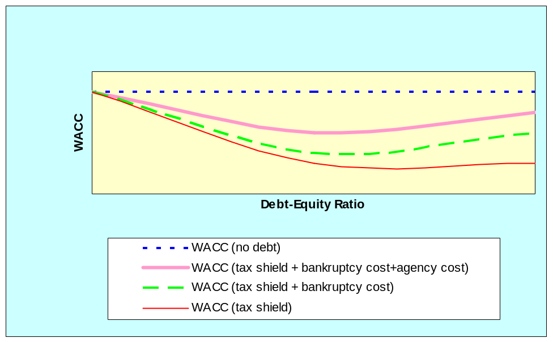
Trade-off Model –
Optimal Capital Structure

Slide 41
Information Asymmetry and Signaling Model
Managers of a company are more informed about the prospects of their company than outside investors. This is the essence of asymmetric information. MM model assumes symmetric information between managers and investors. This asymmetric information can influence the capital structure of a company.

Slide 42
Information Asymmetry and Signaling Model - Implication
A Company should raise less amount of debt than suggested by optimal capital structure based on Trade-off model. This implies that a company should reserve part of its borrowing capacity for issuing debt capital in future in the event of good investment opportunities. It is said that a company should have reserve borrowing capacity.

Slide 43
Pecking Order Model
The model suggests that managers prefer to use retained earnings first for financing investment. They would like to use external debt or equity only if retained earnings are not sufficient to fund investments. Again, managers prefer debt capital if external finance is required. After debt their preference is for hybrid securities like convertible bonds. Managers like to raise equity capital only as a last resort.

Slide 44
Pecking Order Model
According to this model, there is no well-defined target debt-equity ratio and a company’s capital structure at any point of time is simply a reflection of its pecking order preferences for long-term investing.

Slide 45
Leverage Ratchet Effect*
The ratchet effect refers to escalations in production or prices that tend to self-perpetuate.
With debt in place, shareholders pervasively resist leverage reductions no matter how much such reductions may enhance firm value. Shareholders would instead choose to increase leverage even if the new debt is junior and would reduce firm value.
These asymmetric forces in leverage adjustments, which is called the leverage ratchet effect, cause equilibrium leverage outcomes to be history dependent.
If forced to reduce leverage, shareholders are biased toward selling assets relative to potentially more efficient alternatives such as pure recapitalizations.
* Anat R. Admati et.al. The Leverage Ratchet Effect. THE JOURNAL OF FINANCE • VOL. LXXIII, NO. 1 • FEBRUARY 2018

Slide 46
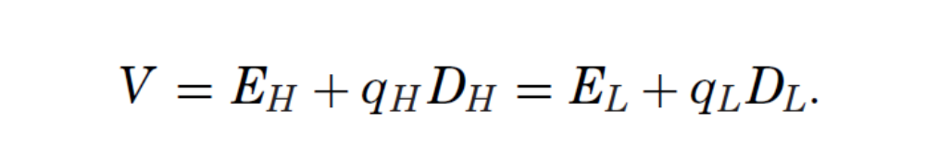
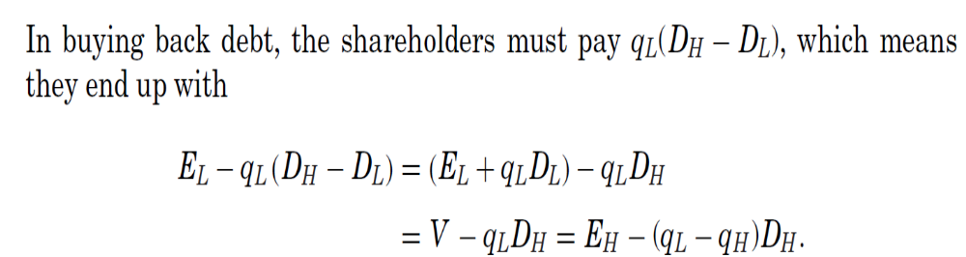
Consider a firm that has one class of debt with total face value D_{H}, and assume that this debt is risky. Will shareholders be willing to use cash or issue equity to buy back some of this debt and reduce the total amount owed to D_{L}?
In perfect markets the total value of the firm, V, will not change with the change in capital structure. Thus, letting EH and EL be the values of equity in the high and low debt capital structures, respectively, and similarly letting qH and qL be the per-unit market values of debt

Slide 47
Market Timing Theory
Baker and Wurgler (2002), claim that market timing is the first order determinant of a corporation's capital structure use of debt and equity.
In other words, firms do not generally care whether they finance with debt or equity, they just choose the form of financing which, at that point in time, seems to be more valued by financial markets.

Slide 48
Making Capital Structure Decision : EBIT-EPS Analysis
A company may have various financing choices to fund investment projects. One widely used method to identify the best alternative is to use EBIT-EPS analysis. Obviously, a company should use that mode of financing which maximizes the earnings per share (EPS) for equity holders.

Slide 49
Multiple Choice Question - 1
A Company increases amount of debt finance in its
capital structure keeping total amount of capital
employed the same. Capital market is perfect with
no taxes. Will the company’s WACC :
a) remain the same
b) fall
c) rise
d) fall to a minimum and then rise

Slide 50
Multiple Choice Question - 1
Ans. (a)

Slide 51
Multiple Choice Question - 2
As a company goes from zero debt to
successively higher levels of debt, what
happens to the value of the company?
a) steadily rises
b) steadily falls
c) rises to a maximum and then falls
d) remains the same

Slide 52
Multiple Choice Question - 2
Ans. (c)

Slide 53
Multiple Choice Question - 4
A Company has some unused land, which, it has
been recently discovered, contains huge quantity
crude oil. The company needs additional funds to
extract the oil. The information has been kept
confidential. How should the company raise the
additional capital?
a) Issue bonds
b) Issue equity
c) Issue convertible bonds
d) Issue bonds and equity in 50 : 50 ratio

Slide 54
Multiple Choice Question - 4
Ans. (a)
Solution: The existing shareholders will
benefit the most if bonds are issued.

Slide 55
Multiple Choice Question - 5
A Company borrows money at 12 % but only
half the interest expense is allowed as a tax
deduction. The corporate tax rate is 40 %.
What is the post-tax cost of debt?
a) 12 %
b) 9.6 %
c) 4.8 %
d) 7.2 %

Slide 56
Multiple Choice Question - 5
Ans. (b)
Solution:
Pre-tax cost of debt for total borrowings = 12 %
Post-tax cost of debt for 50 % of borrowings
= 12 * (1-0.4) = 7.2 %
Post tax cost of debt for the balance 50 % of the borrowings = 12 %
So, post-tax cost of debt
= 0.5 * 7.2 + 0.5 * 12 = 9.6 %

